Slide 1

QUIZ PROGRAM
NAME: M. Ehtesham uz zafar jan. roll# 20k-1655
Name: S.M. Hassan Ali. Roll# 20k-1052
Name: S.m. Raza Ali Abidi. roll# 20k-1061

Slide 2
WORKING
This is a Quiz Program.
In this Program you will be asked 10 IQ questions which you have to solve.
All the questions are Multiple Choice Questions so you have to enter the correct option number.
After answering the 10th question, the program will calculate your score.
After the calculation of score, the program will display your IQ level based on your age and score.
You can also save your score if you want to review it later.
You can also view the scoreboard to check the scores of different people.

Slide 3
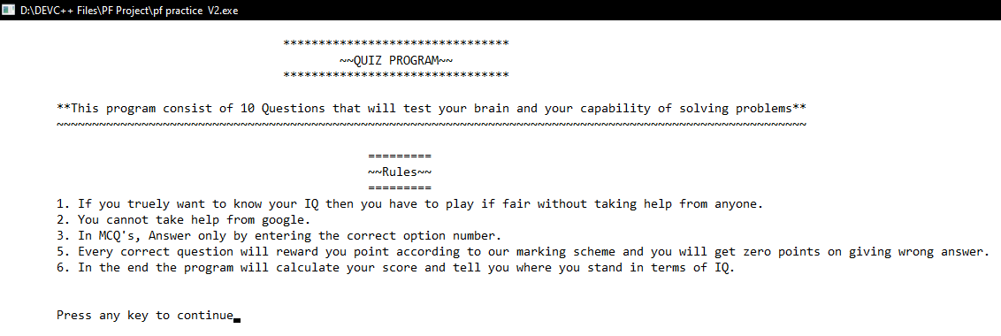
The is the starting screen of the program.
Some rules are mentions here which the user have to follow while using this program.

Slide 4
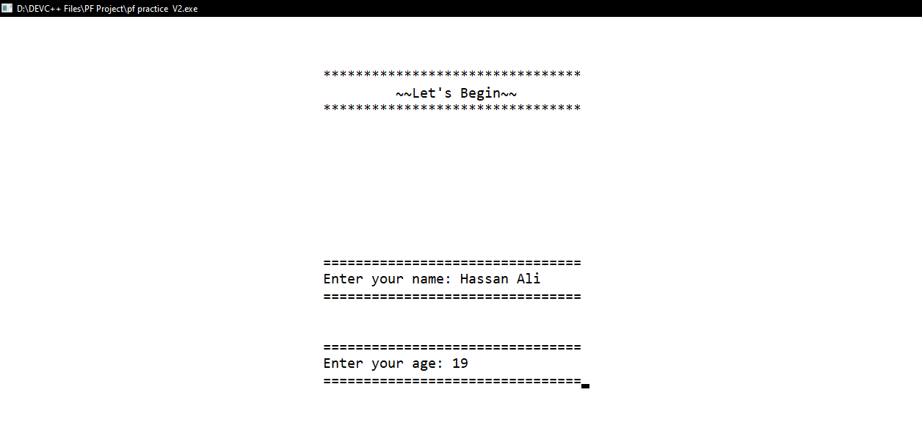
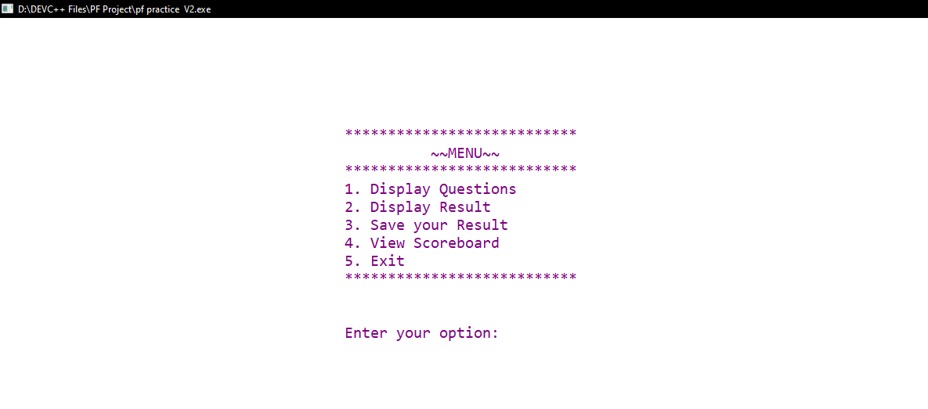
The user will be asked to enter his name and age after the first screen.
After entering his name and age the program will show this menu screen.
By entering option 1, the program will display all the questions.
By entering option 2, the program will display the result and IQ of the user.
By entering option 3, the program will save the user’s name, age, score and IQ.
By entering option 4, the program will display the score broad which will display the data of the previous users along with the data of the current user.
Finally, if you want to exit the program you have to enter option 5.

Slide 5
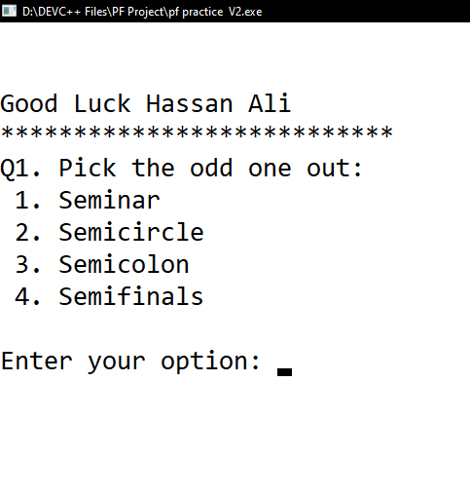
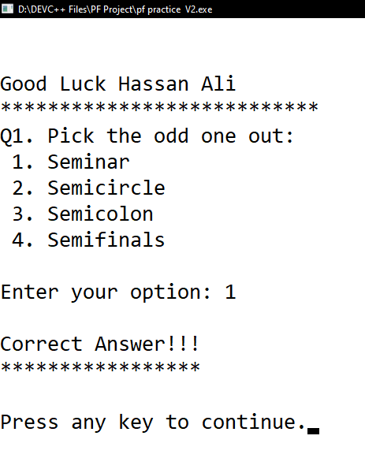
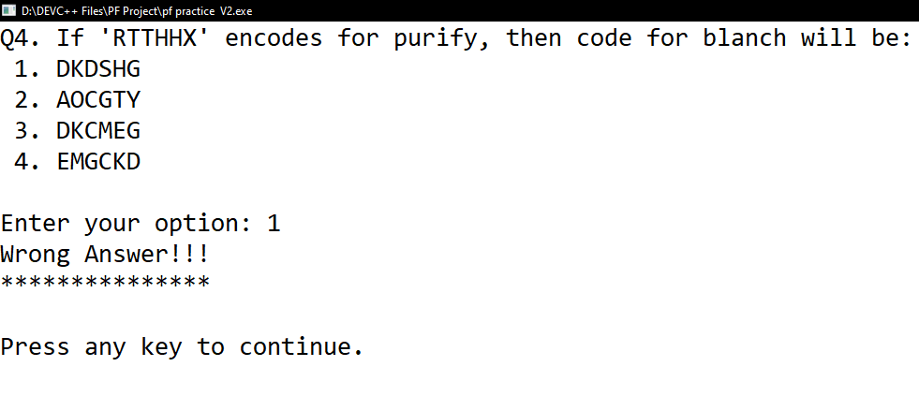
After choosing option 1 from the menu, the program will display “Good Luck (name)” and it will display the first question.
If user enters the correct option, the program will display “Correct Answer”
If user enters the wrong option, the program will display “Wrong Answer”
In this way, the program will display a series of 10 questions which the user have to answer.

Slide 6
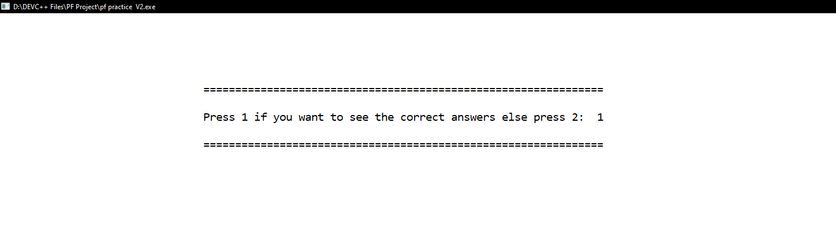
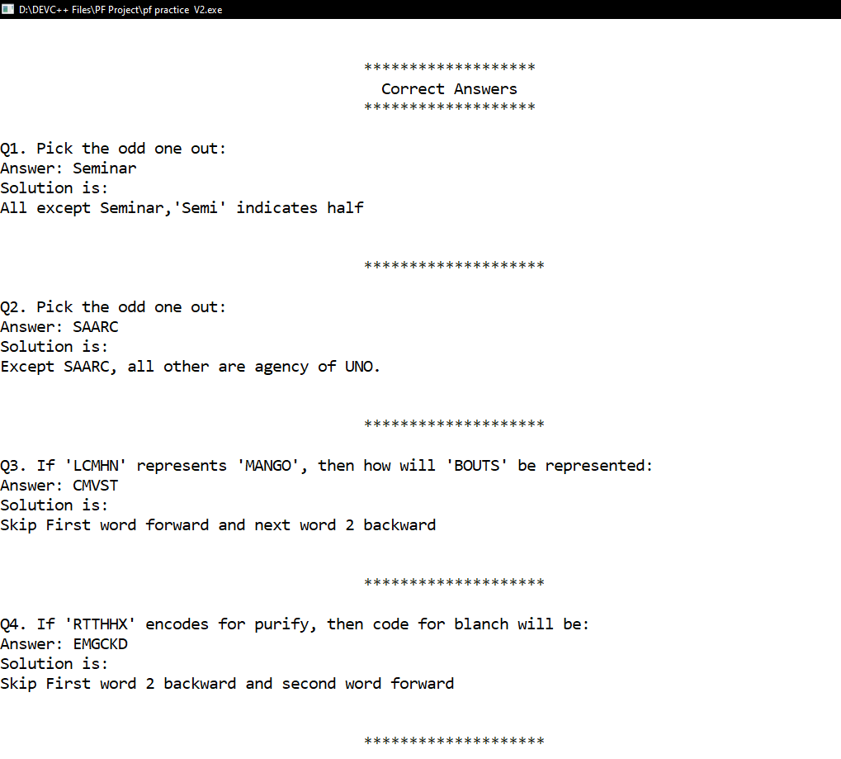
After completing the Questions the program will ask the user if he/she wants to see the correct answers.
By entering 1, the program will display the correct answer of every question and it will also display the solution of the answers. In this way, the user will understand how to deal with IQ questions and what are the tricks to solve these questions.
If user enters option 2, the program will take him/her to the menu screen and from there he/she can select the desired option.

Slide 7
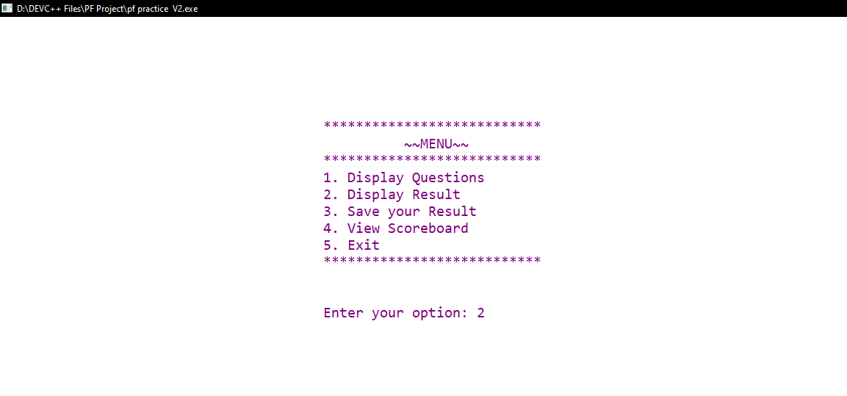
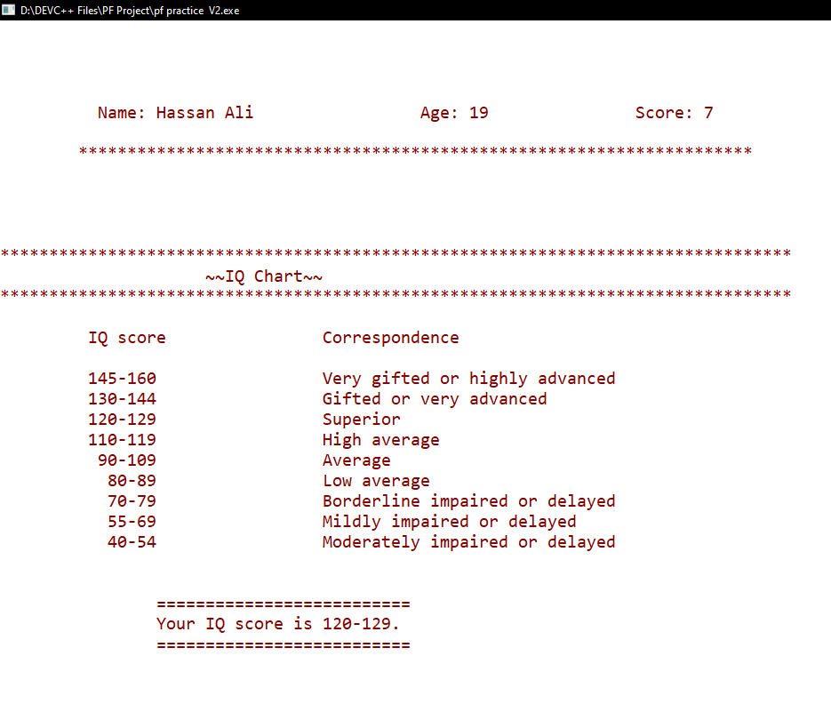
If the user enter option 2 from the menu, the program will display the name age and score of the user.
The program will display the IQ chart which contains all the IQ scores and their correspondence.
After that the program will display the IQ of the User.

Slide 8
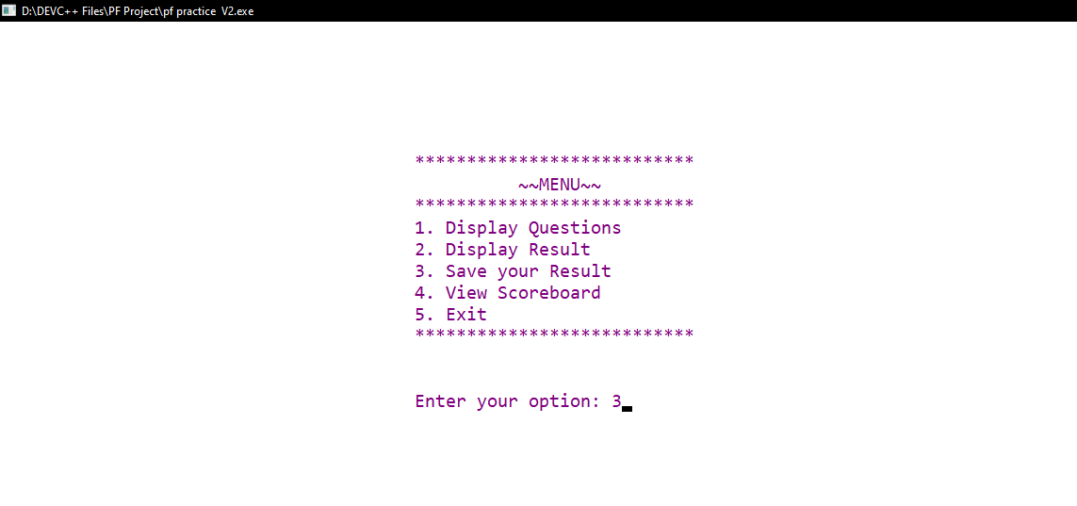
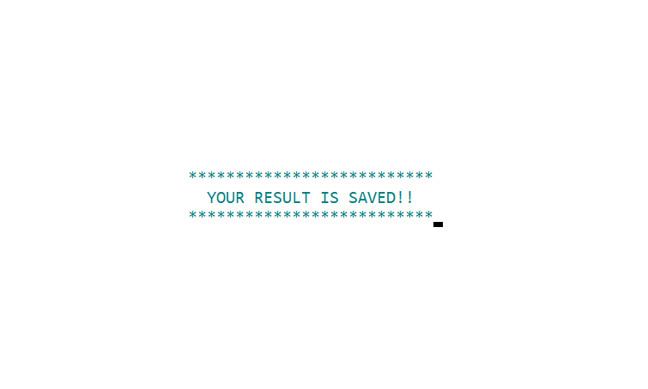
By choosing option 3 from the menu, program will save the name, age, score and the IQ of the user.

Slide 9
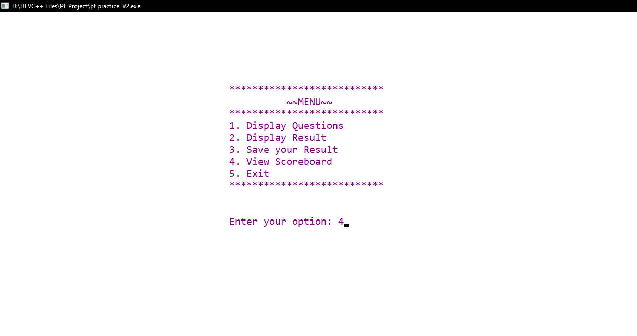

By entering option 4, program will display the whole score board.
Score board contains all the data of the previous users along with the data of the current user.

Slide 10
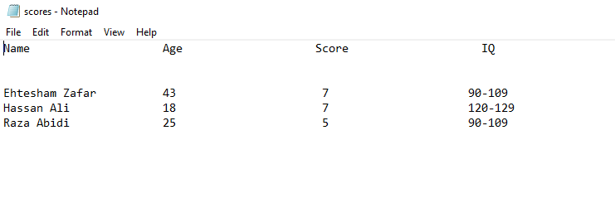
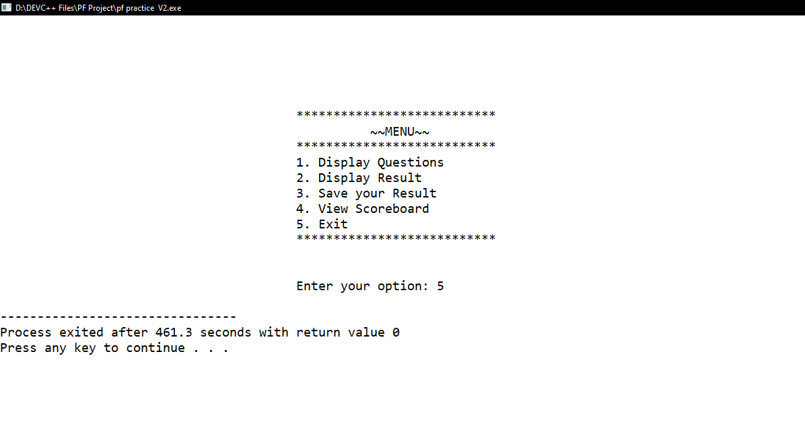
This is the .txt file named as scores.
This file is storing all the data of the users and when the user enter option 2 from the menu, the program reads this file and display it’s content on the scoreboard.
Finally, be entering option 5 from the menu, the program will shut down.

Slide 11
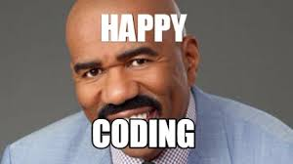
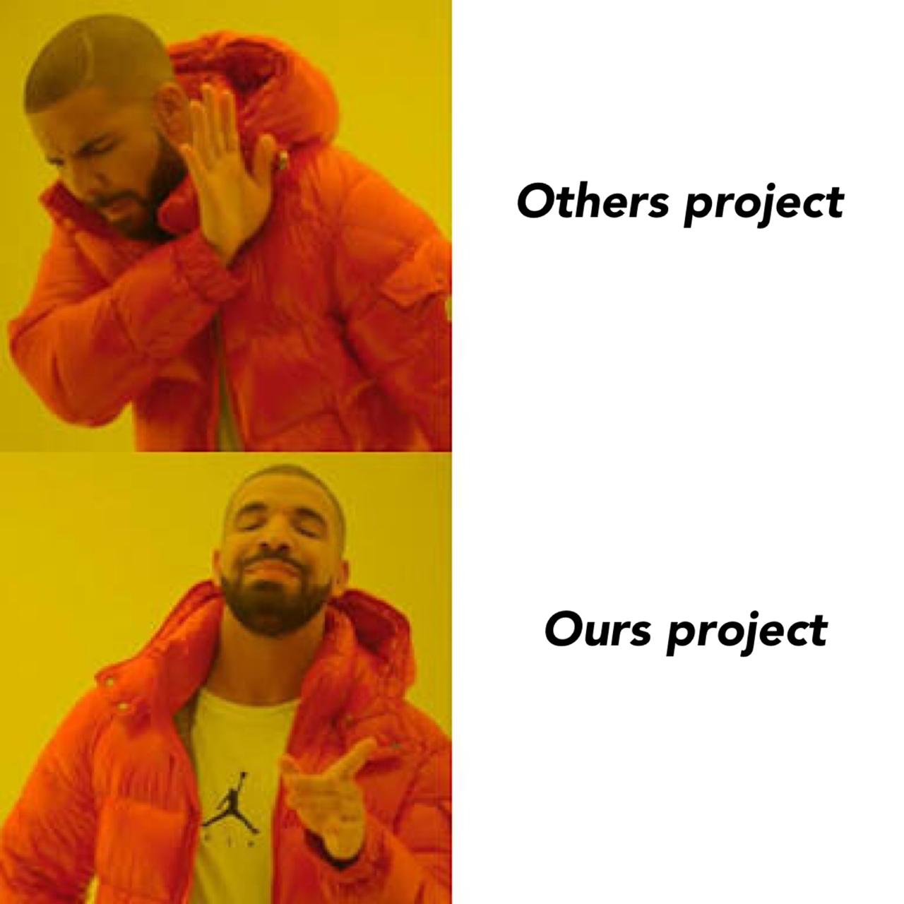
THANKYOU

